Slide 1

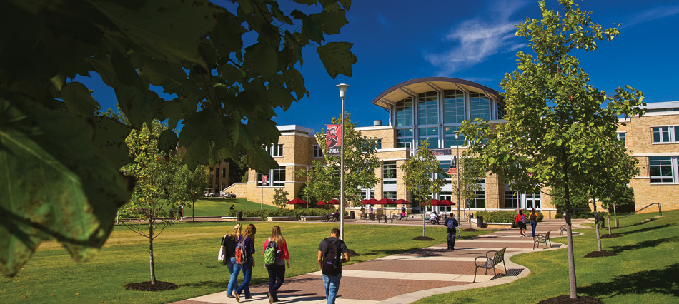

Syllabi Creation
Summer 2020 Workshop: Content Series #11
presented by: Dr. Summer DeProw
July 29, 2020
AState.edu
/ArkansasState
@ArkansasState

Slide 2



Workshop Procedures
Welcome and thank you for participating in our Summer Workshop Series!
You will be muted upon entry to the workshop, so please introduce yourself via the Chat feature by clicking “Chat.”
The window to the right will appear where you can add your introduction:
If you have questions during the session, please add them to the Chat box and at the conclusion of our time we will include them in the Q and A.
AState.edu
/ArkansasState
@ArkansasState

Slide 3
Workshop Agenda
Attendees will be able to:
Create Syllabi with all applicable University, Program and Course information present, including answering the following questions:
  Does the course description on the syllabus match the course description in the current bulletin?
  Are there Program Learning Outcomes (PLOs) listed on the syllabus?
  Is this course a part of an academic program and if so, does the course appear on the program’s curriculum map in Taskstream?
  Do the PLOs listed on the syllabus match the markings on the map in Taskstream?
Include COVID19 and other required and suggested University-wide statements in all syllabi
AState.edu
/ArkansasState
@ArkansasState

Slide 4
Setting the Tone with a Syllabus
The University of Iowa says this about the importance of using a syllabus to set the tone for a course:
“The tone of the syllabus helps sets the tone of the course. A positive tone helps students engage in their own learning endeavor. An authoritarian or scolding tone does not welcome or encourage their collaboration in the teaching-and-learning process. Describe the syllabus as an educational “promise” not a “contract.””
Indiana University adds this:
“The tone and style of your syllabus can help you establish appropriate expectations for your students regarding how you perceive your role as an instructor and their roles as students.”
Lastly Vanderbilt University says:
Researchers have explored the effect of “warm” and “cold” language in a syllabus on student perceptions of the instructor. An example of “warm” language in a syllabus is “I hope you actively participate in this course. I say this because I found it is the best way to engage you in learning the material (and it makes lectures more fun.)” “Cold” language, on the other hand, expresses the same idea using different words: “Come prepared to actively participate in this course. This is the best way to engage you in learning the material (and it makes the lectures more interesting.)” Students who read the syllabus with the “warm” language rated the hypothetical instructor both more approachable and more motivated to teach the class (Harnish and Bridges 2011).
AState.edu
/ArkansasState
@ArkansasState

Slide 5
Functions of a Syllabus
The syllabus must consider information policies, procedures, structure, function and audiences from all of the following:
University
Program
Course
College
Department
AState.edu
/ArkansasState
@ArkansasState

Slide 6
Functions of a Syllabus
The most fundamental function of a syllabus is to establish communication between faculty and students. More specifically, a course syllabus serves to:
Inform students of University policies and procedures including disability services, weather, COVID19, etc.
Provide links for campus-wide information
List program learning outcomes and goals
Show connections between course and program
State the Instructor’s name, contact information and office hours
List course learning outcomes and goals
State the course’s content, readings and other materials
Provide course policies, including grading, attendance and other expectations
Sets timeline for lectures, examinations and other course dates
Anything else important to the structure, function and execution of the course
AState.edu
/ArkansasState
@ArkansasState

Slide 7
Who is reading your syllabus?!
Audiences for syllabi go beyond your current students. Other readers include:
  Accrediting Bodies
  Registrars
  Employers or Certification Officers
  Enrolled and Potential Students
  Grievance Committees
  Alf?!
AState.edu
/ArkansasState
@ArkansasState

Slide 8
Who is reading your syllabus?!
One professor slipped a question to his students amongst other information in his syllabi to see who was reading it in this Chronicle of Higher Education Article:
“Is Anybody Reading the Syllabus? To Find Out, Some Professors Bury Hidden Gem”
Other methods that faculty use to ensure students are reading syllabi include:
  Syllabi Quizzes
  Reflection on their expectations for the course
  Hidden “Gems”
  Others???
AState.edu
/ArkansasState
@ArkansasState

Slide 9
Components of a Syllabus
Course Information including: Full Name, Course Number, CRN, Location, Days and Time, and Description from Current Bulletin
Instructor Information including: Name, Title, Specialty, Contact Information, Office Hours and Location
Program Learning Outcomes
Course Learning Outcomes
University, College, Department, Program, Course Procedures, Policies and Information
Course Content
Required Materials
Course Expectations
Course Timeline
Required Components including: Statements on Disability Accommodations, Weather, Title IX, COVID19, Grading, etc.
For a complete list of A-State’s syllabus recommendations, please see Appendix C of the Assessment Manual here: http://www.astate.edu/a/assessment/index.dot
AState.edu
/ArkansasState
@ArkansasState

Slide 10
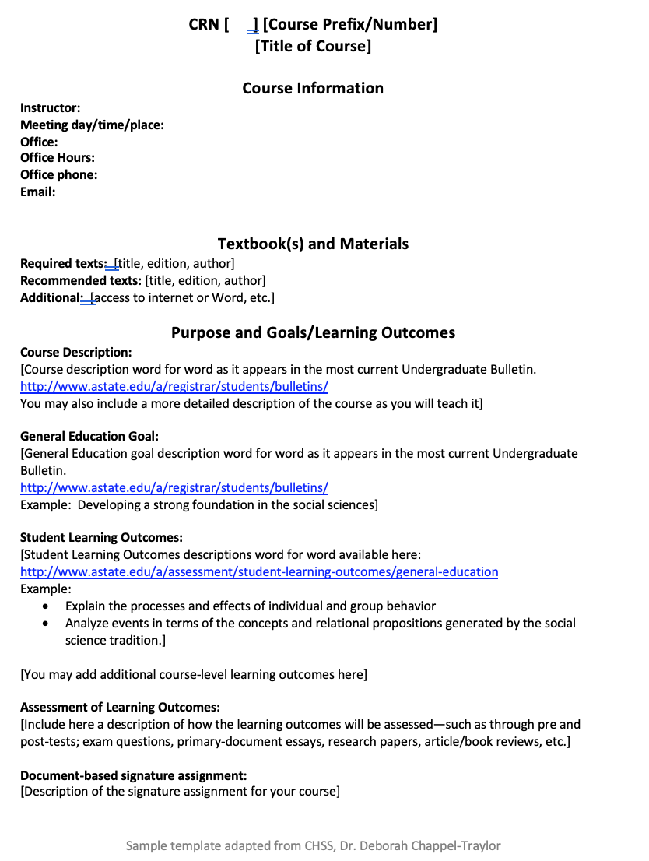
Syllabi Model: General Education Course
AState.edu
/ArkansasState
@ArkansasState
http://www.astate.edu/a/assessment/index.dot

Slide 11
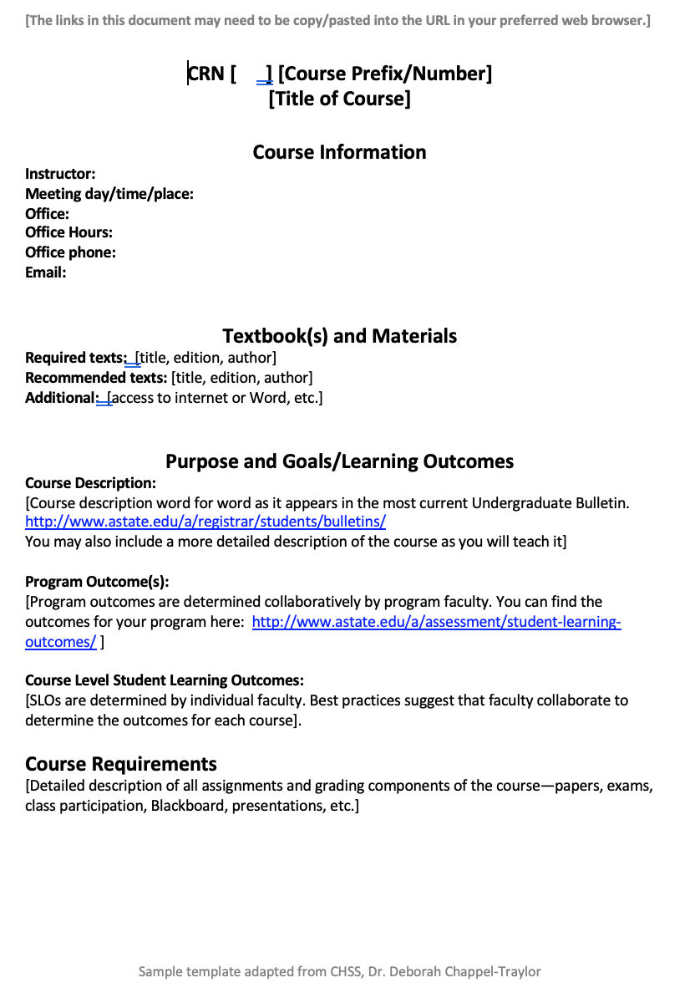
Syllabi Model: Undergraduate Course
AState.edu
/ArkansasState
@ArkansasState
http://www.astate.edu/a/assessment/index.dot

Slide 12
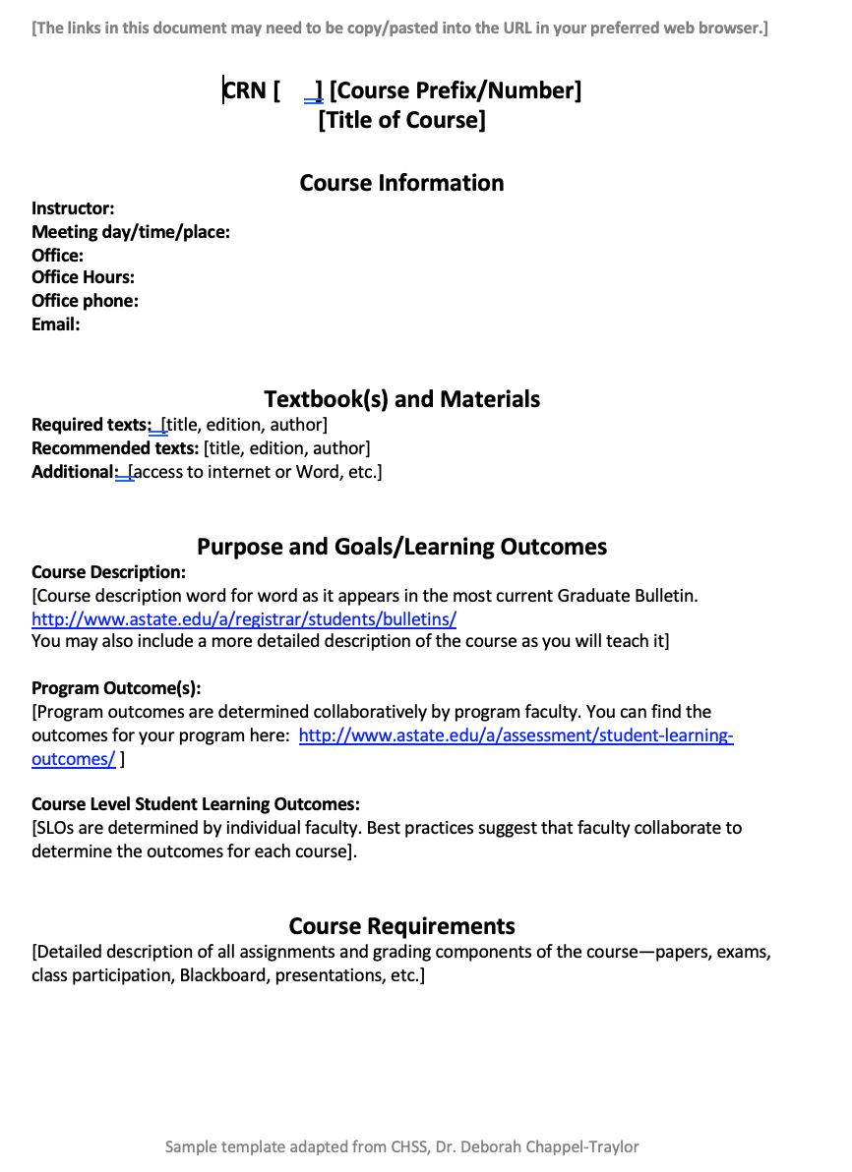
Syllabi Model: Graduate Course
AState.edu
/ArkansasState
@ArkansasState
http://www.astate.edu/a/assessment/index.dot

Slide 13
Syllabi Review Guiding Questions
  Does the course description on the syllabus match the course description in the current bulletin?
  Are there Program Learning Outcomes (PLOs) listed on the syllabus?
  Is this course a part of an academic program and if so, does the course appear on the program’s curriculum map in Taskstream?
  Do the PLOs listed on the syllabus match the markings on the map in Taskstream?
  Additionally, if the course is a General Education course:
    Is/Are the Gen Ed Goal and Outcome/s listed?
AState.edu
/ArkansasState
@ArkansasState

Slide 14
Syllabi Review Data
Department 1:
Department 2:
Analysis Item | Count | Percent
The correct syllabi were submitted. | 56 | 84%
The syllabi were incorrect or missing. | 11 | 16%
Total Reviewed | 67
The course description was correct. | 27 | 48%
The course description was incorrect. | 29 | 52%
Number of Service Courses* | 7
PLO's were listed. | 35 | 71%
PLO's were not listed. | 14 | 29%
The program has a completed curriculum map in taskstream. | 34 | 69%
The program did not have a completed curriculum map in taskstream. | 15 | 31%
The PLO's matched the completed curriculum map in taskstream. | 11 | 22%
The PLO's did not matched the completed curriculum map in taskstream. | 38 | 78%
Analysis Item | Count | Percent
The correct syllabi were submitted. | 76 | 100%
The syllabi were incorrect or missing. | 0 | 0%
Total Reviewed | 76
The course description was correct. | 73 | 96%
The course description was incorrect. | 3 | 4%
Number of Service Courses* | 0
PLO's were listed. | 73 | 96%
PLO's were not listed. | 3 | 4%
The program has a completed curriculum map in taskstream. | 72 | 95%
The program did not have a completed curriculum map in taskstream. | 4 | 5%
The PLO's matched the completed curriculum map in taskstream. | 58 | 76%
The PLO's did not matched the completed curriculum map in taskstream. | 18 | 24%
AState.edu
/ArkansasState
@ArkansasState

Slide 15
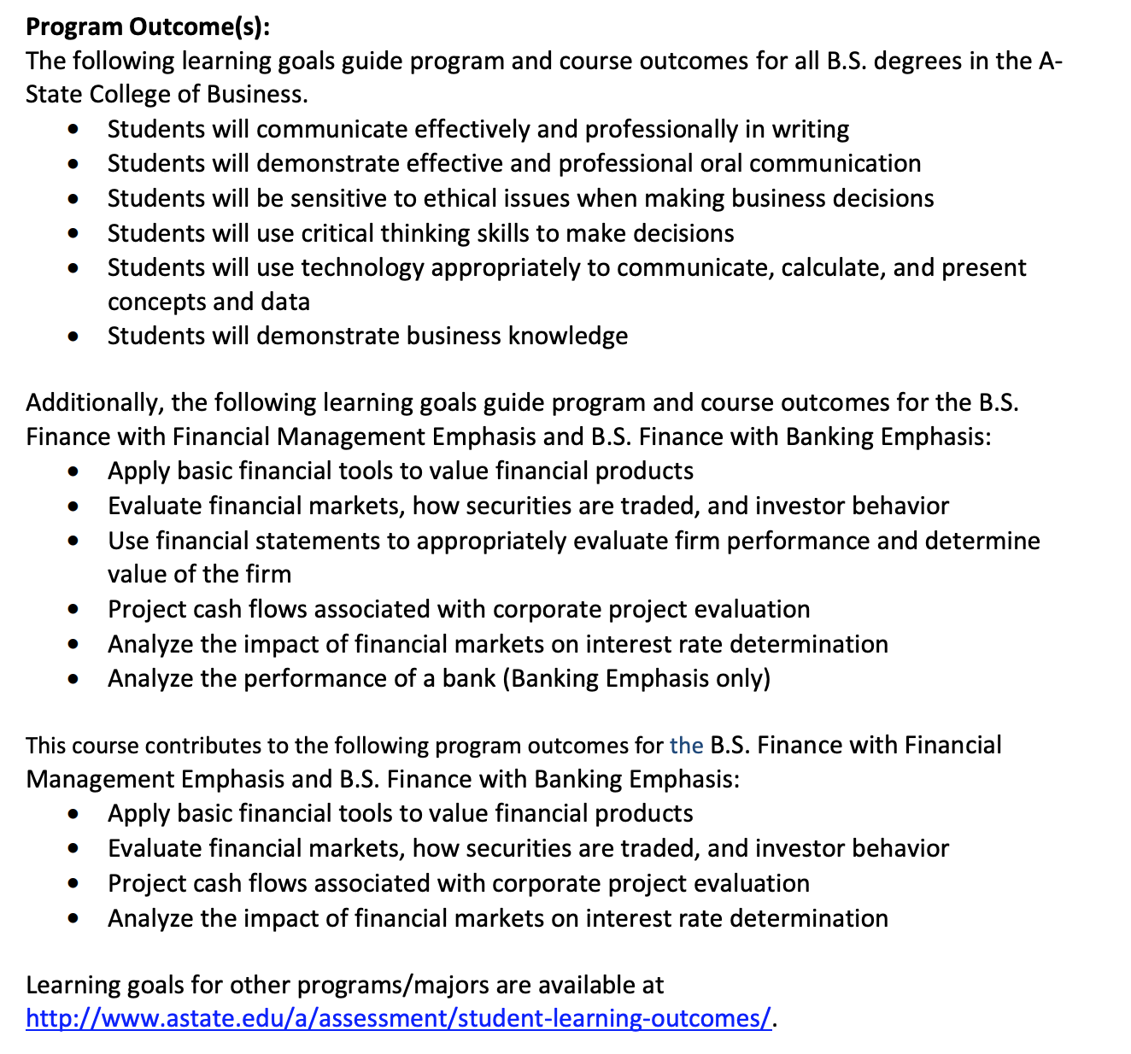
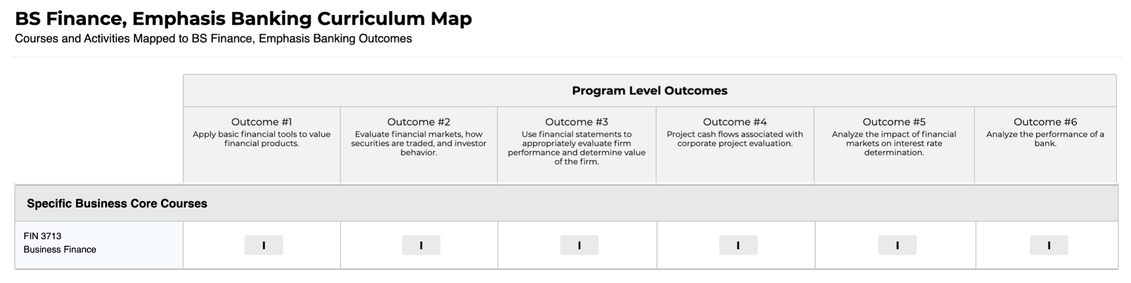
Examples of Curriculum Map Communication in Syllabi
There are numerous ways to communicate mapping of program and course curriculum in a syllabus.
One example is to create a PDF version of a map built in Taskstream, add the map as an appendices in the syllabi and state that a course’s alignment can be found in the map.
The following are two examples of curriculum mapping communication.
Syllabi example courtesy of Dr. Jim Washam, Professor
AState.edu
/ArkansasState
@ArkansasState

Slide 16
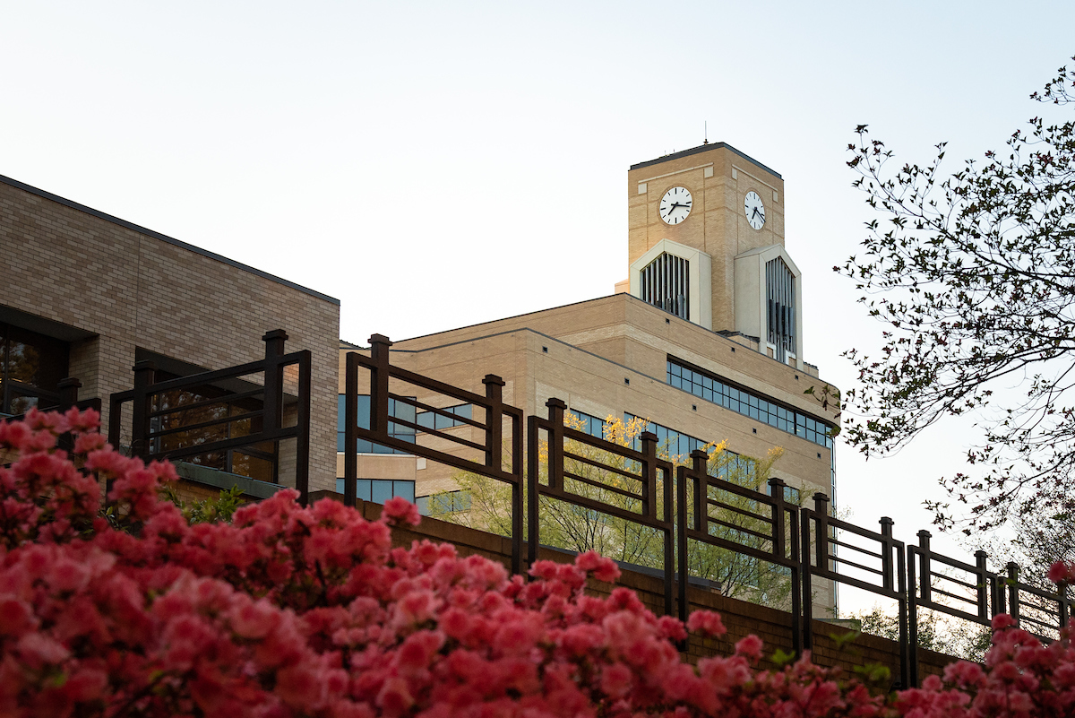
Session Q & A
AState.edu
/ArkansasState
@ArkansasState

Slide 17
References and Resources
University of Indiana-Bloomington, Center for Innovative Teaching and Learning
https://citl.indiana.edu/teaching-resources/course-design/syllabus-construction/index.html
University of Iowa, Office of Teaching, Learning and Technology
https://teach.its.uiowa.edu/handbook-teaching-excellence-6th-edition/planning-ahead-and-first-day-class/syllabus-construction
Vanderbilt University, Center for Teaching
https://cft.vanderbilt.edu/guides-sub-pages/syllabus-design/
Zamudio-Suaréz, F. (2020, July 22). Is Anybody Reading the Syllabus? To Find Out, Some Professors Bury Hidden Gems. Retrieved July 28, 2020, from https://www.chronicle.com/article/is-anybody-reading-the-syllabus-to-find-out-some-professors-bury-hidden-gems/
AState.edu
/ArkansasState
@ArkansasState

